Slide 1
Fundamentals of planning

Slide 2
Definition of Planning
Planning involves determination of future course of action to achieve the desired results.

Slide 3
Feature of planning
Process rather than behaviour
Forecasting future situation
Involves selection of suitable course of action
Undertaken at all levels of organizations
Flexible as well as commitment
Pervasive and continuous

Slide 4
Nature of planning
Rational approach
Open system approach
pervasiveness

Slide 5
Importance of planning
Primacy of planning
To offset uncertainty and change
To focus attention on objectives
To help in coordination
To help in control
To increase organizational effectiveness

Slide 6
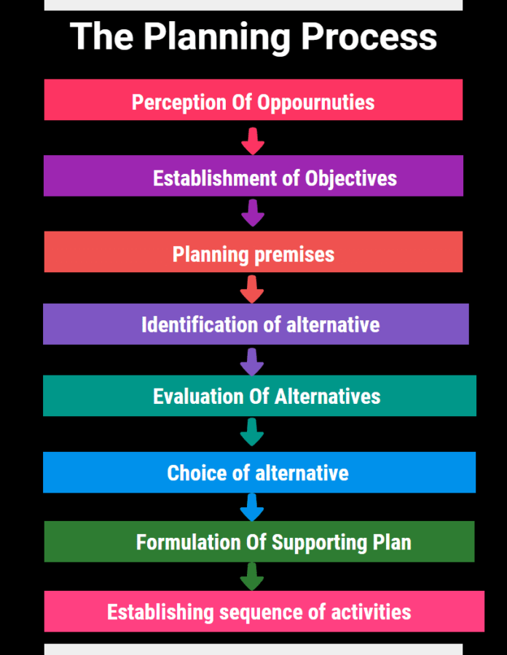

Slide 7
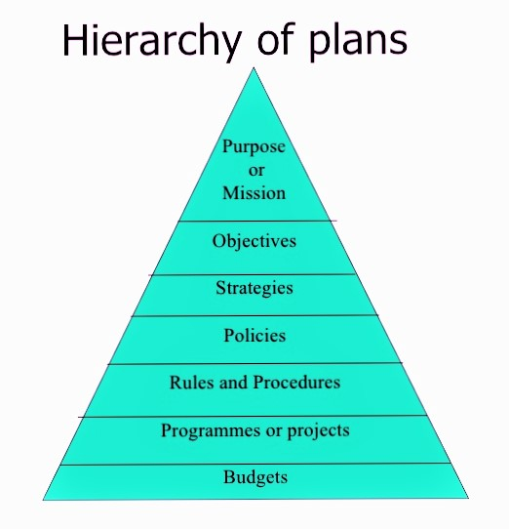

Slide 8
Purpose or Mission
A mission statement is a simple statement that explains your company's goals. It's a summary of what your company does for its customers, employees, and owners. It explains how you do what you do. And, it focuses on why your company does what it does.
McDonald's Mission Statement
McDonald's brand mission is to be our customers' favorite place and way to eat and drink. Our worldwide operations are aligned around a global strategy called the Plan to Win, which center on an exceptional customer experience – People, Products, Place, Price and Promotion. We are committed to continuously improving our operations and enhancing our customers' experience.

Slide 9
Objectives
A specific result that a person or system aims to achieve within a time frame and with available resources. In general, objectives are more specific and easier to measure than goals. Objectives are basic tools that underlie all planning and strategic activities. They serve as the basis for creating policy and evaluating performance. Some examples of business objectives include minimizing expenses, expanding internationally, or making a profit.
For example one of the objectives of an organization could be to increase sales by 20%.
The main objective of the McDonald's corporation is to be the customer's favorite place to eat. To achieve this, McDonald's created a global strategy called "Plan to Win," which focuses on creating an extraordinary customer experience.

Slide 10
Strategy
This obviously is the next type of plan, the next step that follows objectives. Strategy generally involves setting goals and priorities, determining actions to achieve the goals, and mobilizing resources to execute the actions. A strategy describes how the ends (goals) will be achieved by the means (resources).
McDonald's supports this intensive growth strategy by using low prices to compete in new markets. Product Development. McDonald's uses product development as its tertiary or supporting intensive strategy for growth.

Slide 11
Policies
A set of policies are principles, rules, and guidelines formulated or adopted by an organization to reach its long-term goals and typically published in a booklet or other form that is widely accessible.
It is an organization’s general way of understanding, interpreting and implementing strategies. Like for example, most companies have a return policy or recruitment policy or pricing policy etc.
Policies are made across all levels of management, from major policies at the top-most level to minor policies. The managers need to form policies to help the employees navigate a situation with predetermined decisions. They also help employees to make decisions in unexpected situations.

Slide 12
Procedure
Procedures are the next types of plan. They are a stepwise guide for the routine to carry out the activities. These stepwise sequences are to be followed by all the employees so the activities can be fulfilled in an organized manner.
The procedures are described in a chronological order. So when the employees follow the instructions in the order and completely, the success of the activity is pretty much guaranteed
Take for example the procedure of admission of a student in a college. The procedure starts with filling out an application form. It will be followed by a collection of documents and sorting the applications accordingly

Slide 13
Rules
Rules are very specific statements that define an action or non-action. Also, rules allow for no flexibility at all, they are final. All employees of the organization must compulsorily follow and implement the rules. Not following rules can have severe consequences.
Rules create an environment of discipline in the organization. They guide the actions and the behavior of all the employees of the organization. The rule of “no smoking” is one such example

Slide 14
Programmes
Programmes are an in-depth statement that outlines a company’s policies, rules, objectives, procedures etc. These programmes are important in the implementation of all types of plan.
They create a link between the company’s objectives, procedures and rules.
Primary programmes are made at the top level of management. To support the primary program all managers will make other programs at the middle and lower levels of management.

Slide 15
Budget
A budget is a statement of expected results the managers expect from the company. Budgets are also a quantitative statement, so they are expressed in numerical terms. A budget quantifies the forecast or future of the organization.
There are many types of budgets that managers make. There is the obvious financial budget, that forecasts the profit of the company. Then there are operational budgets generally prepared by lower-level managers. Cash budgets monitor the cash inflows and outflows of the company.

Slide 16
Types of planning
On the basis of | Types
Coverage of activities | Corporate planning Functional planning
Importance of contents | Strategic planning Operational planning
Time period involved | Long term planning Short term planning
Approach adopted | Proactive planning Reactive planning
Degree of formalization | Formal planning Informal planning

Slide 17
Difference between planning and plan
Planning is an activity and process while plan is a commitment to a course of action

Slide 18
Types of plans
Standing and single use plans
Strategic and operational plans

Slide 19
Planning premises
Refers to a proposition stated or assumed at the beginning of a deed

Slide 20
Types of planning premises
External premises and internal premises
Tangible and intangible premises
Controllable and uncontrollable premises

Slide 21
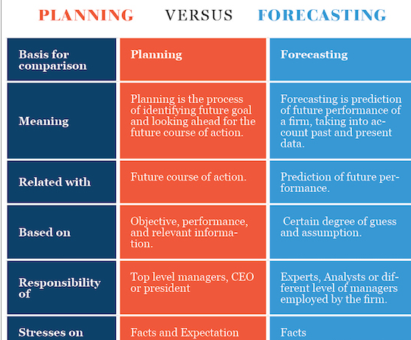
Difference between planning and forecasting

Slide 22
Effective planning
Linked to long term objectives
Direction for action
Consistent
Simplicity
Flexible

